Slide 1
PURPLE - 02
유신이네 조

Slide 2
CONTENTS
001/ Role sharing
002/ Meeting activities
003/ Functional introduction
004/ Main activities

Slide 3
01
Role sharing
김유신 /
안예지 /
남정훈 /
윤영훈 /
이소원 /

Slide 4
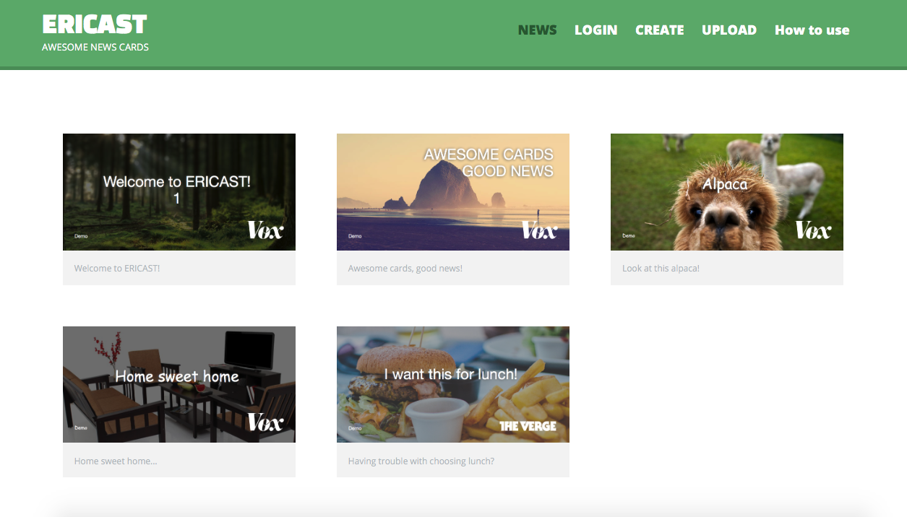
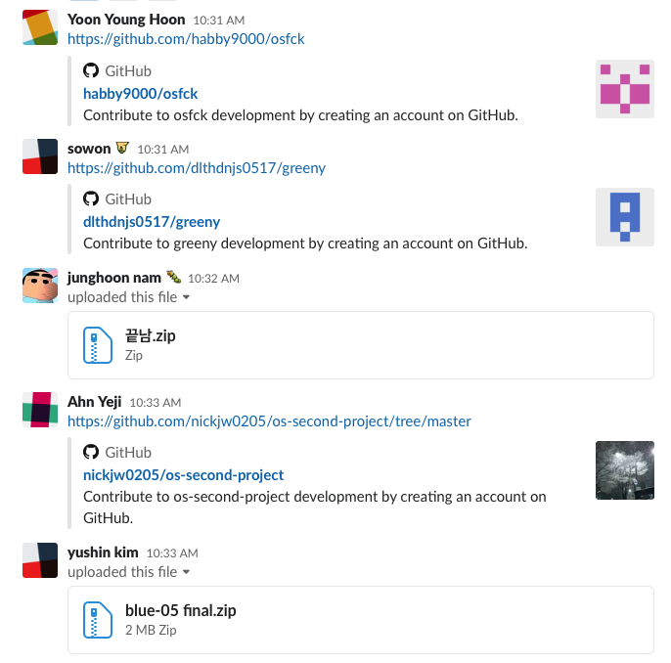
02
Meeting activities
11.16 | 11.20 | 11.23 | 11.27 | 11.30 | 12.04

Slide 5
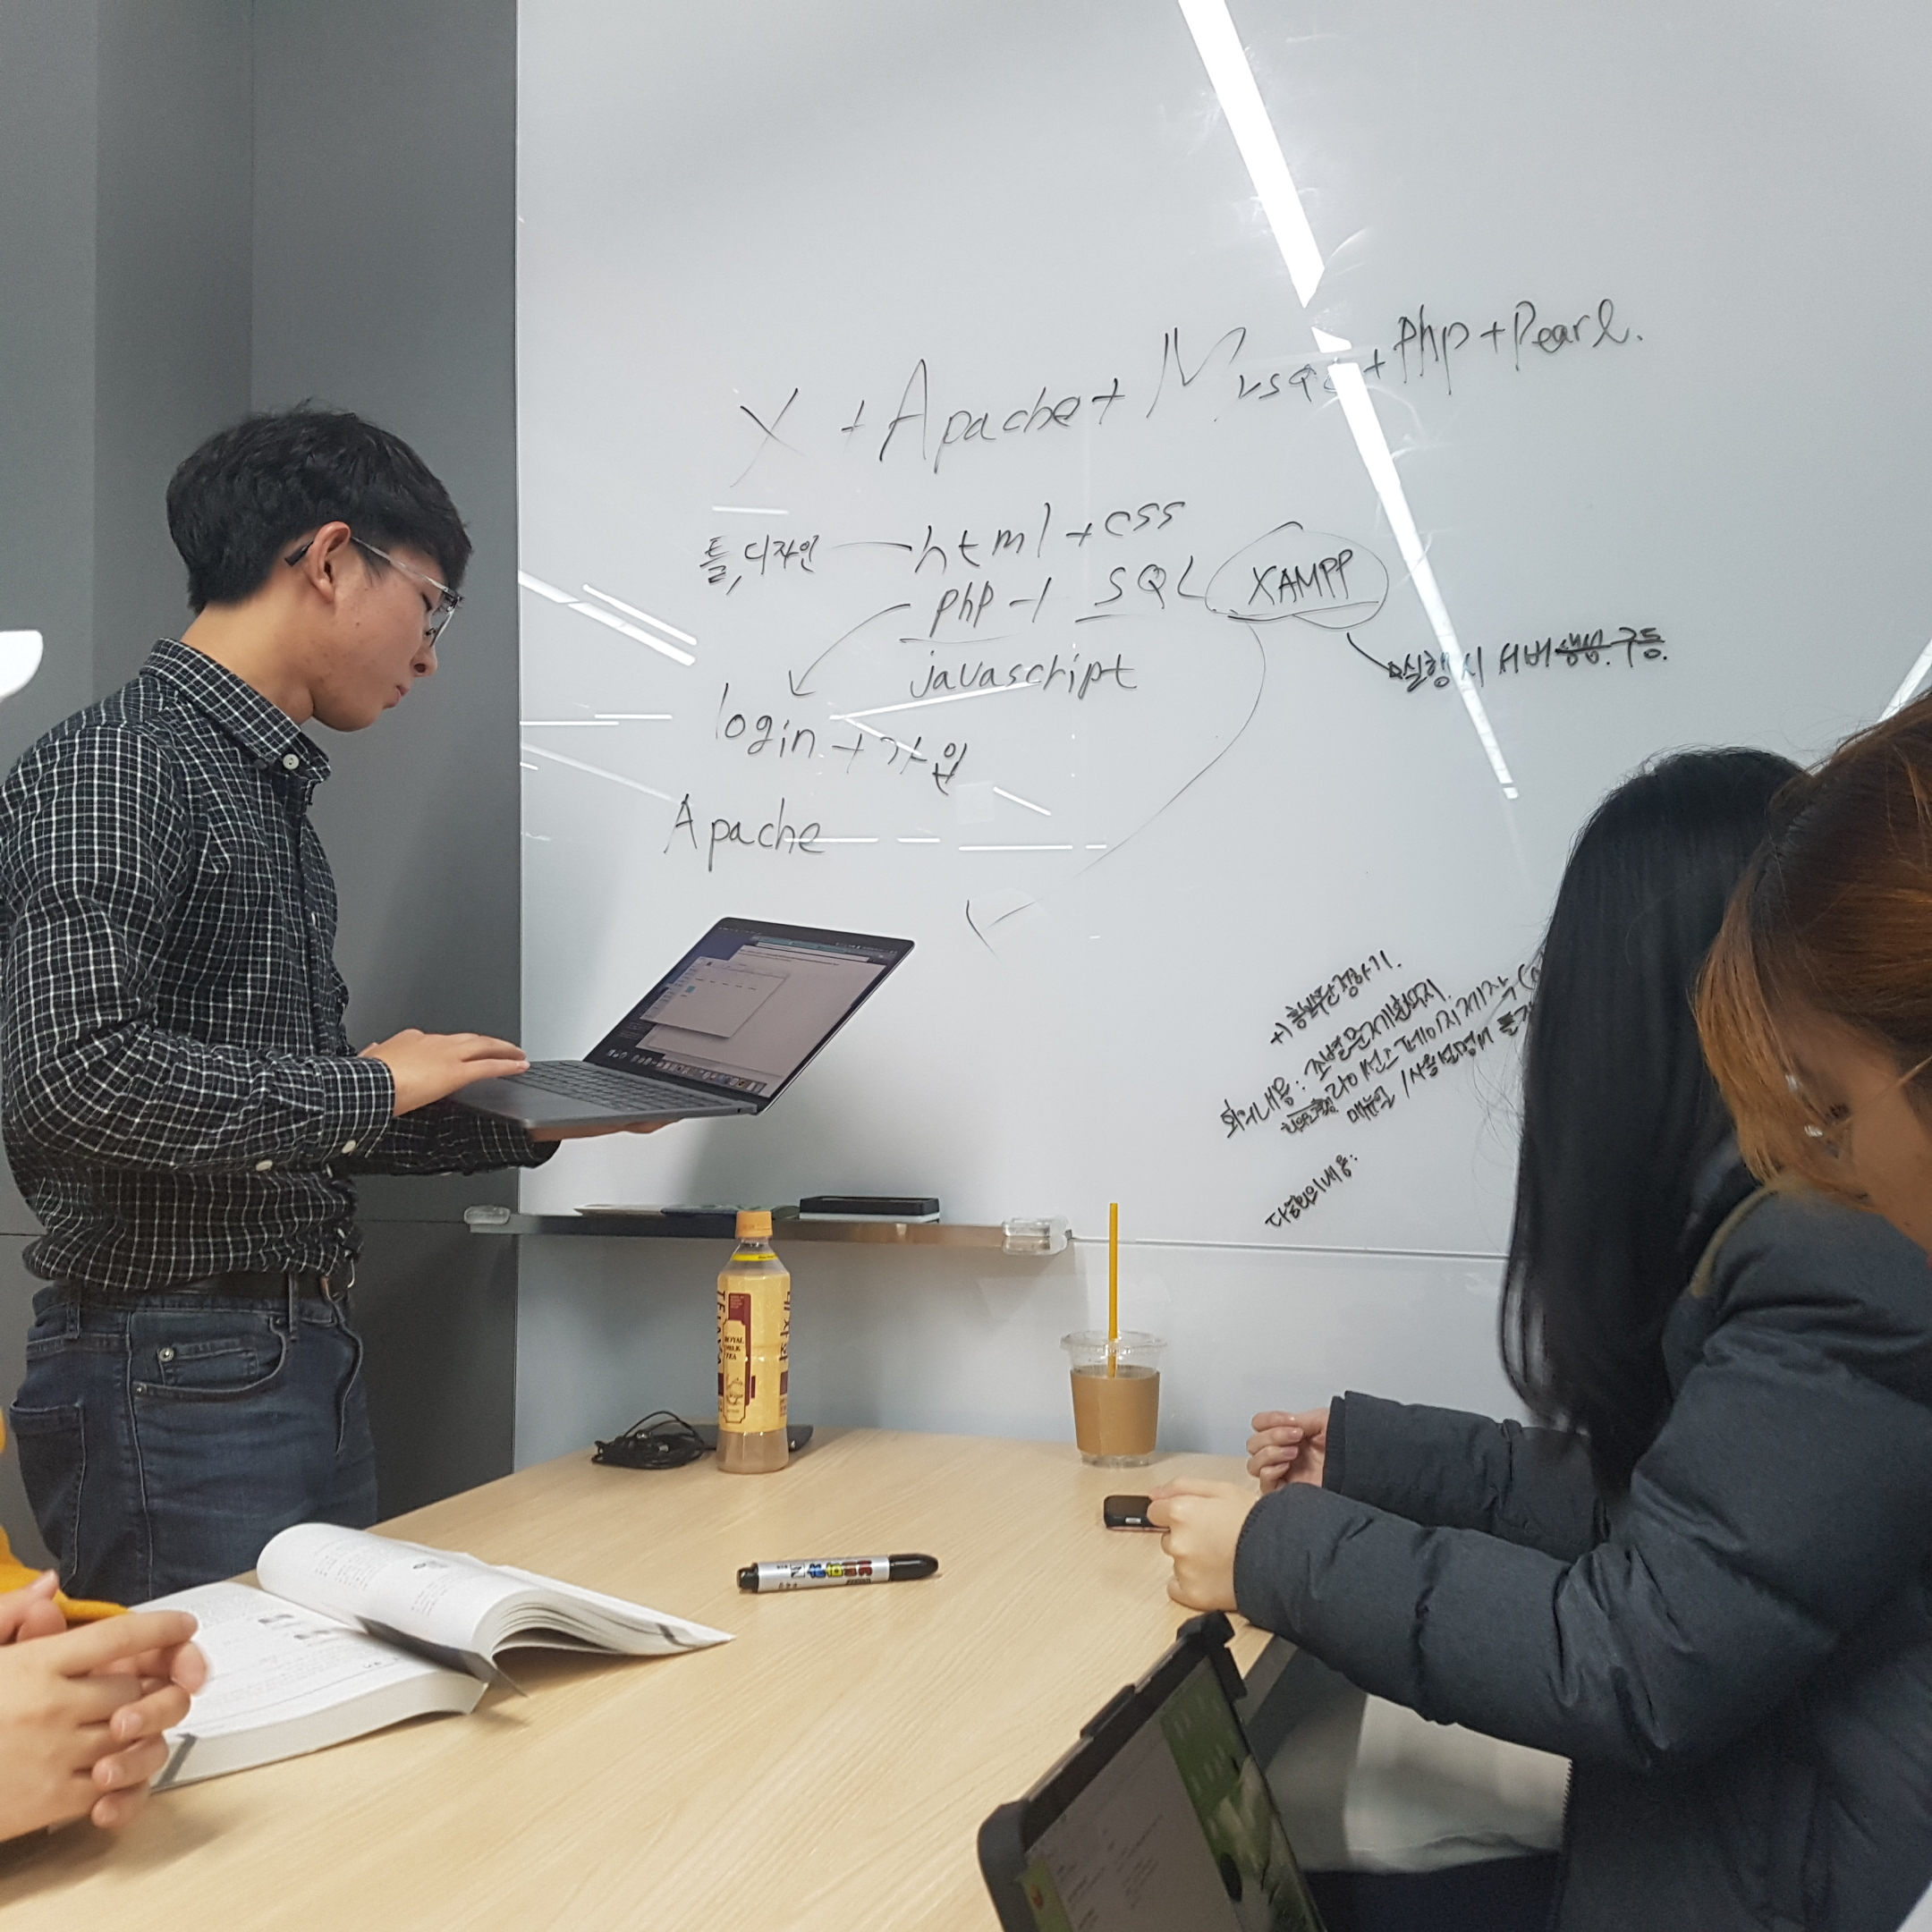
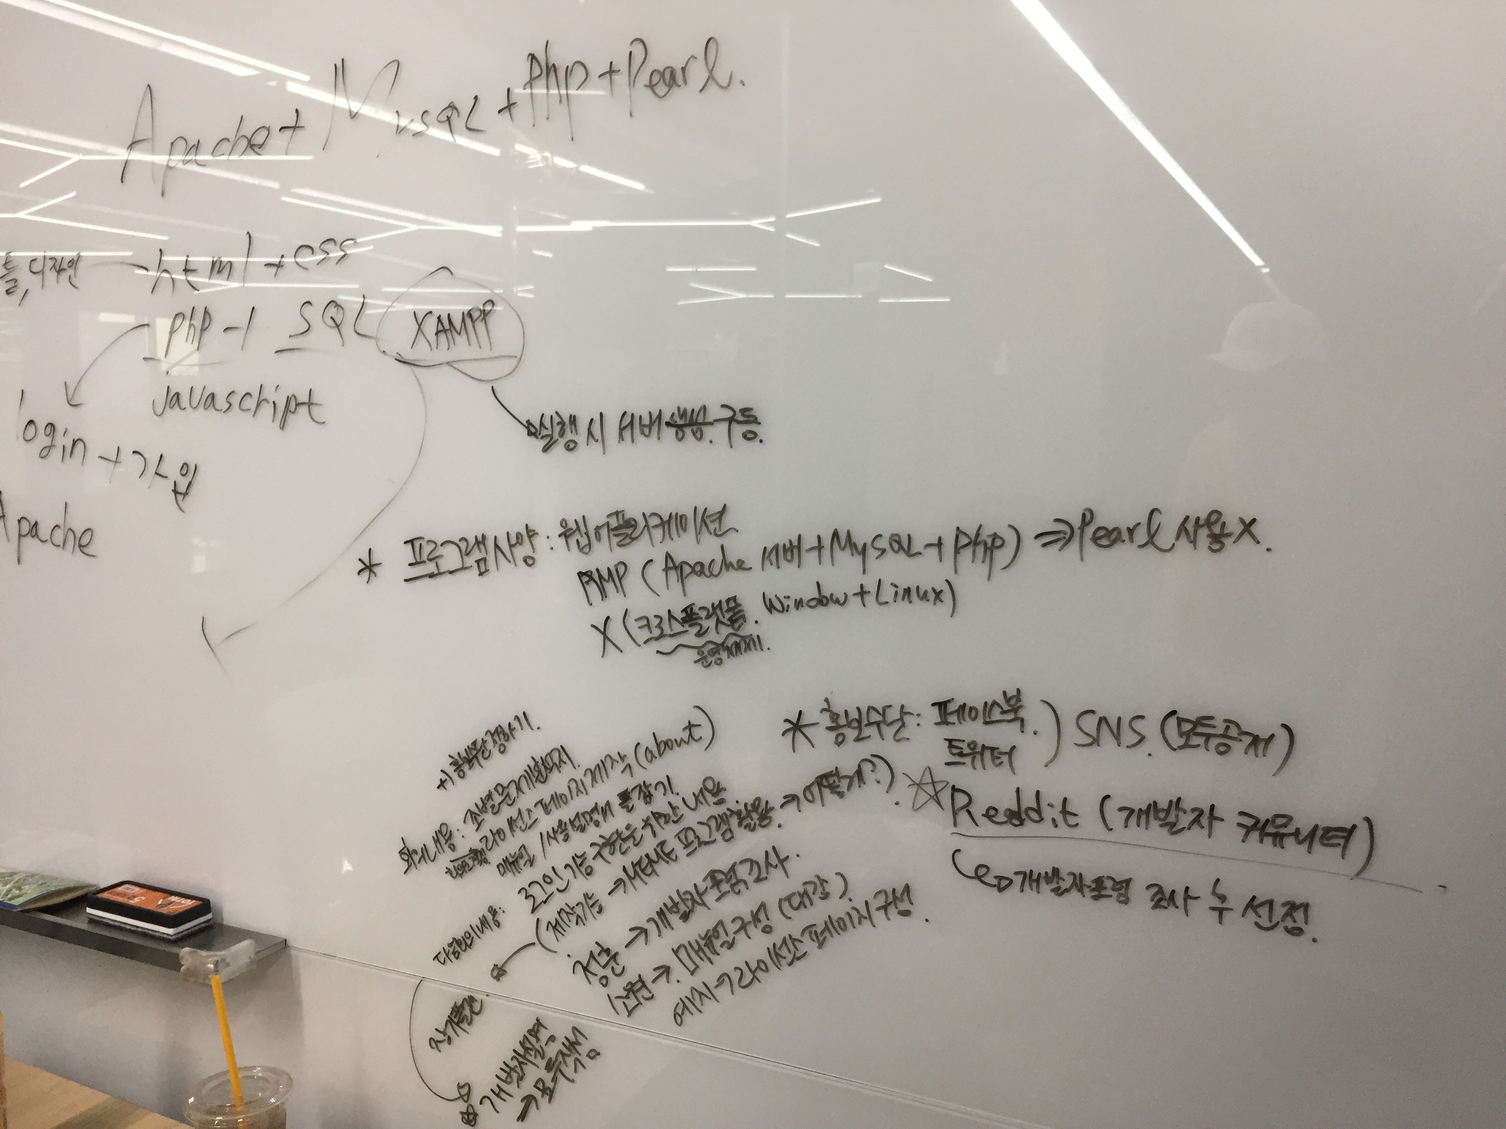
02
Meeting activities
11.16 | 11.20 | 11.23 | 11.27 | 11.30 | 12.04

Slide 6
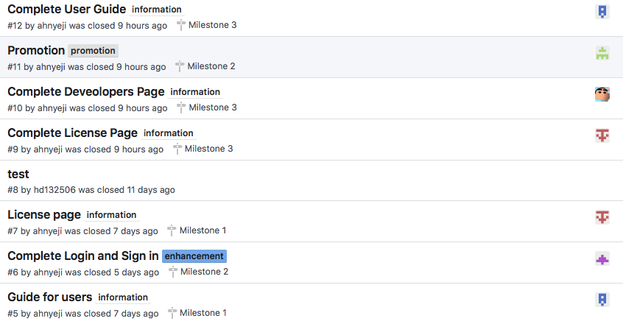
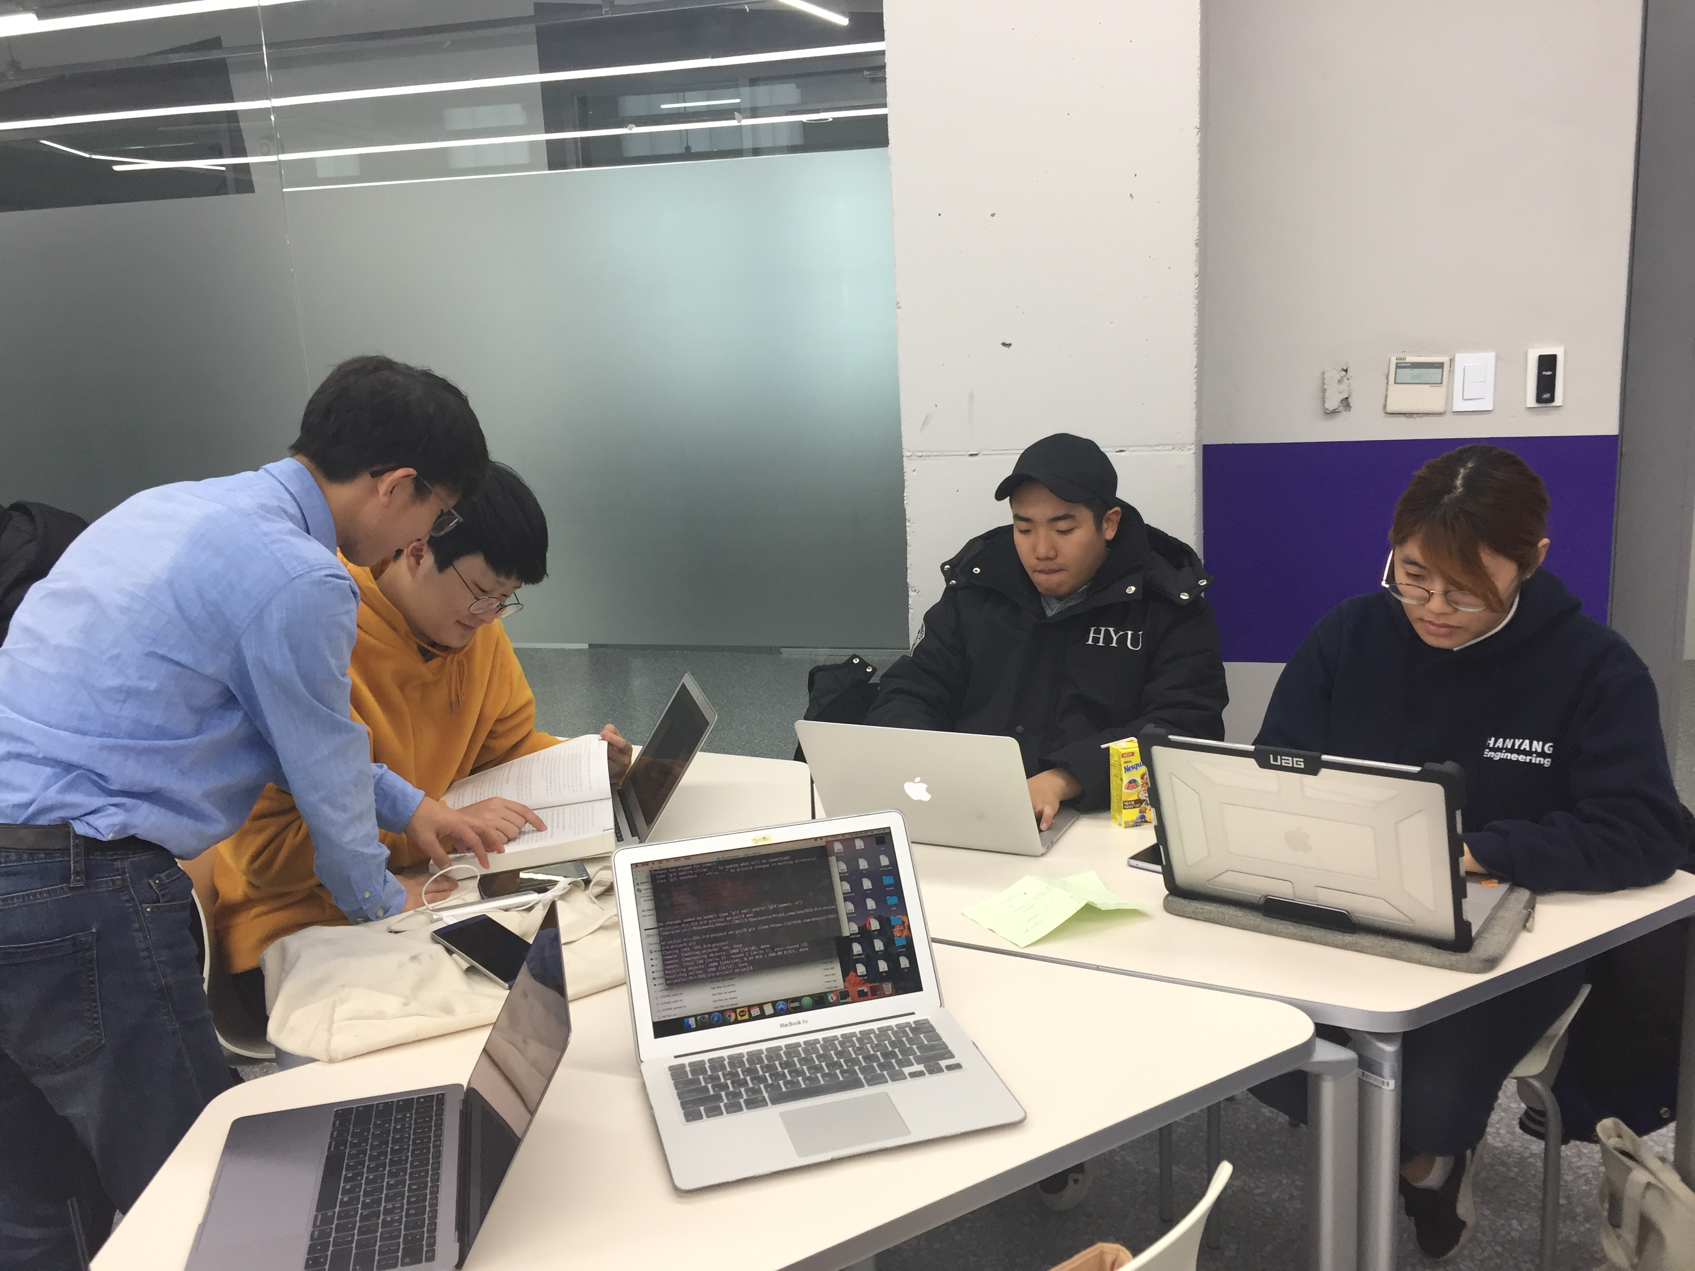
02
Meeting activities
11.16 | 11.20 | 11.23 | 11.27 | 11.30 | 12.04

Slide 7
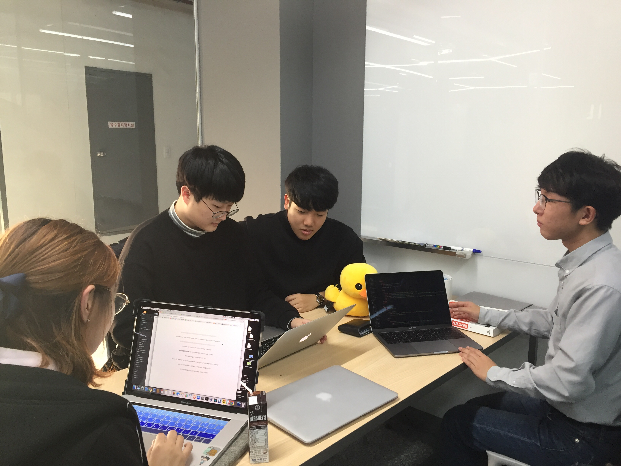
02
Meeting activities
11.16 | 11.20 | 11.23 | 11.27 | 11.30 | 12.04

Slide 8
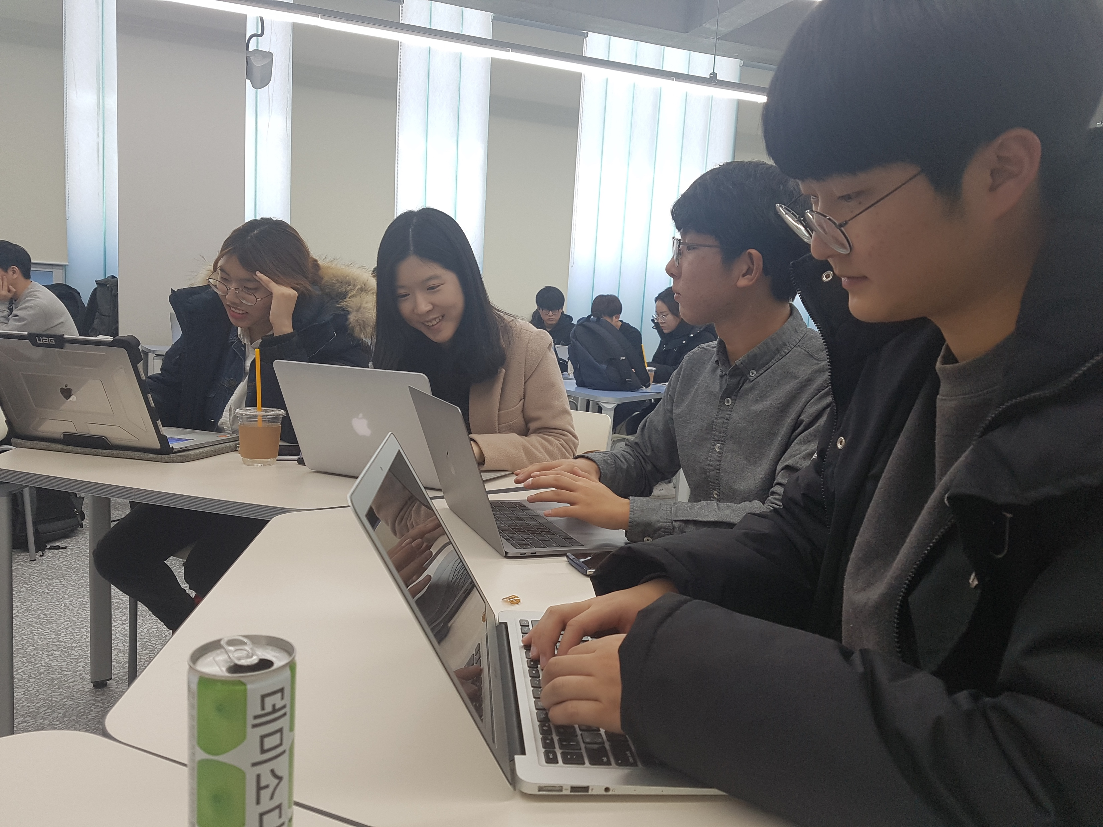
02
Meeting activities
11.16 | 11.20 | 11.23 | 11.27 | 11.30 | 12.04

Slide 9
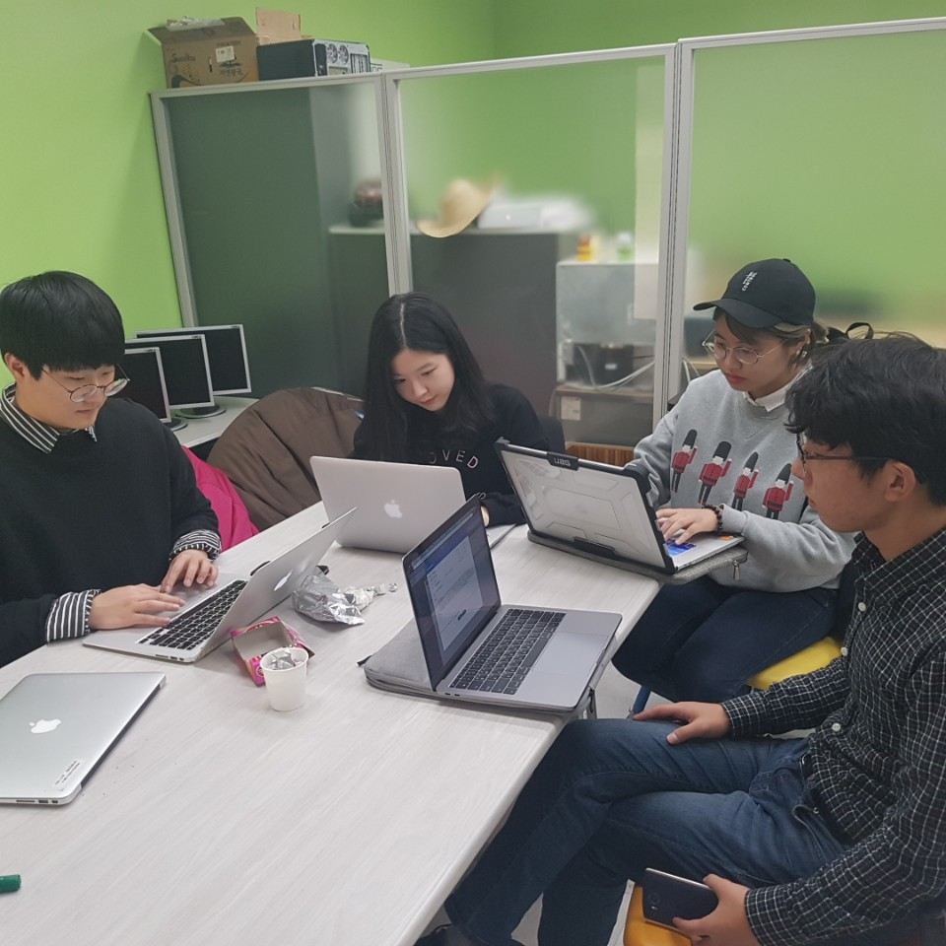
02
Meeting activities
11.16 | 11.20 | 11.23 | 11.27 | 11.30 | 12.04

Slide 10
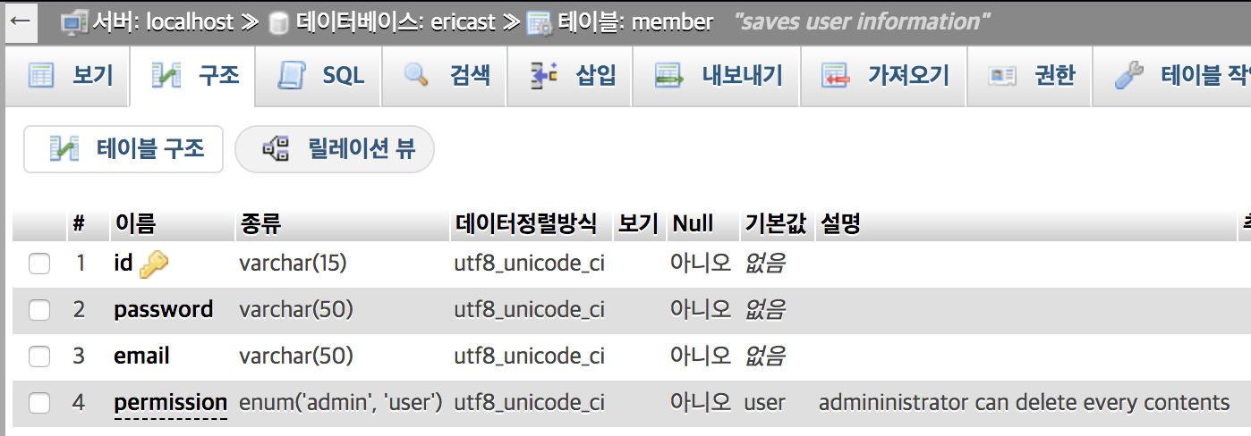
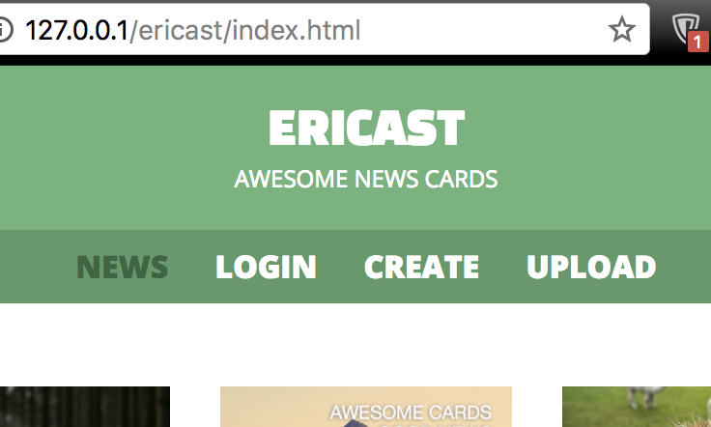
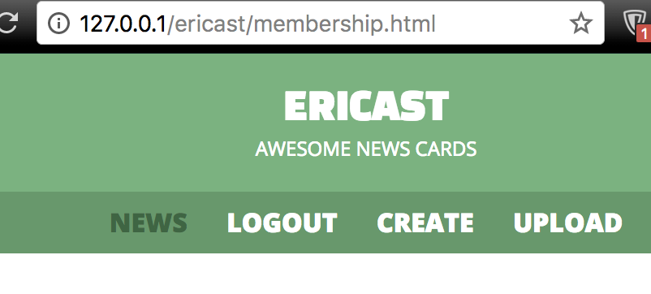
03
Functional introduction
Logout
Login
User Database

Slide 11
04
Main activities - 라이센스
MIT License | Apache License | BSD 3-clause License
Flat HTML5/CSS3 LOGIN Form | Slides | meme
How to Make a Website
Knockout Files Bindings with upload preview and drag & drop
RRSSB
Bootstrap

Slide 12
04
Main activities – 사용자를 위한 온라인 매뉴얼

Slide 13
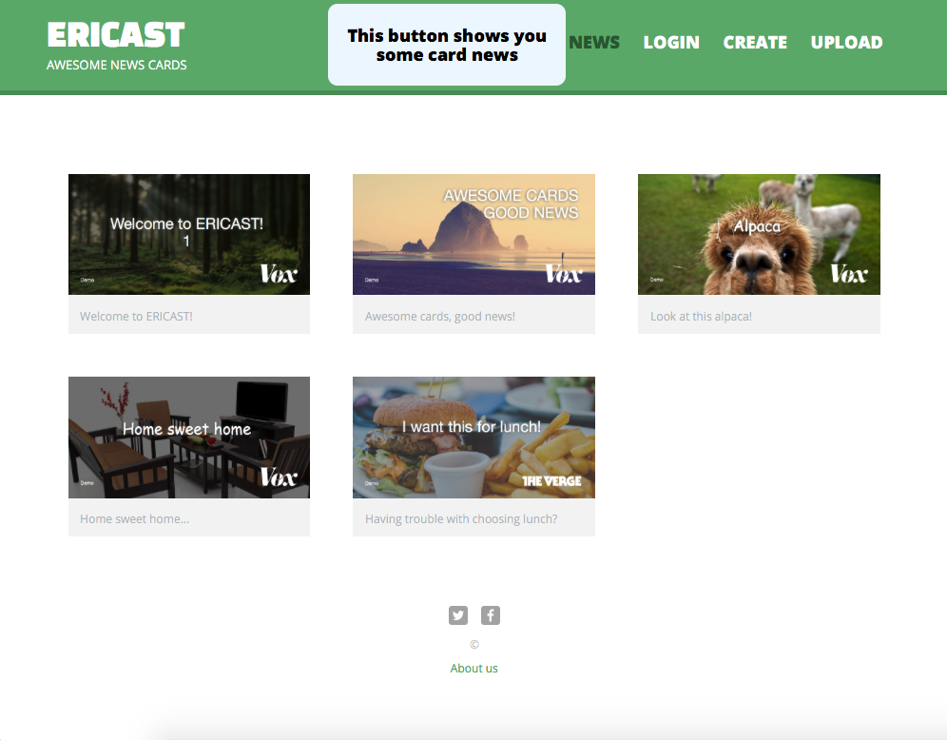
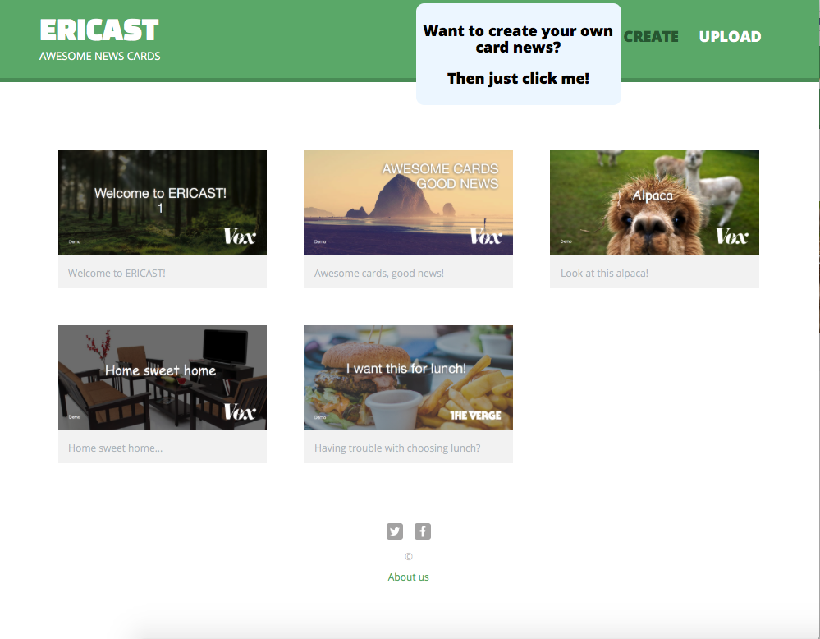
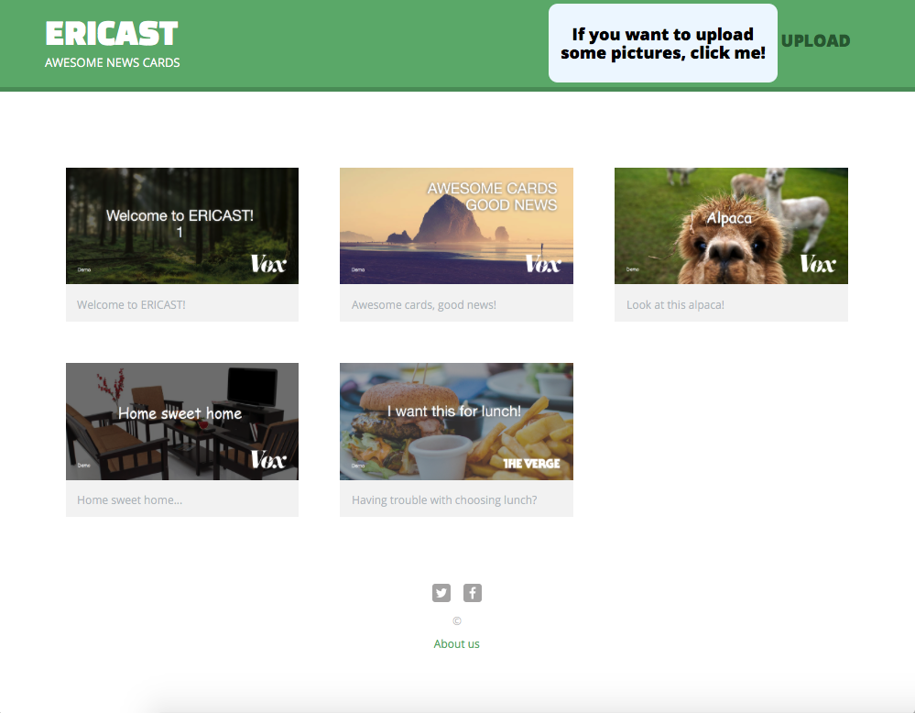
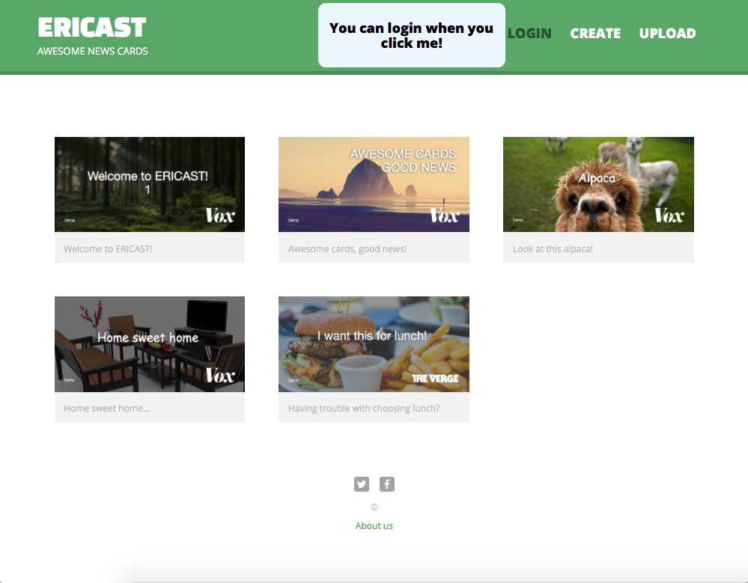
04
Main activities – 사용자를 위한 온라인 매뉴얼

Slide 14
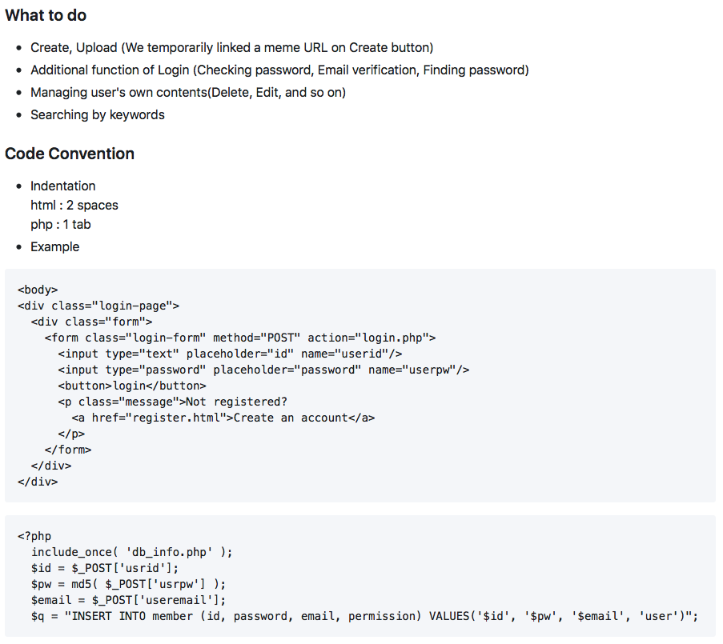
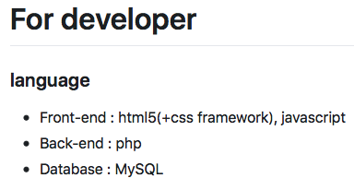
04
Main activities – 개발자들을 위한 사양 설명서 & 개발 참여 방법 안내를 포함한 요소

Slide 15
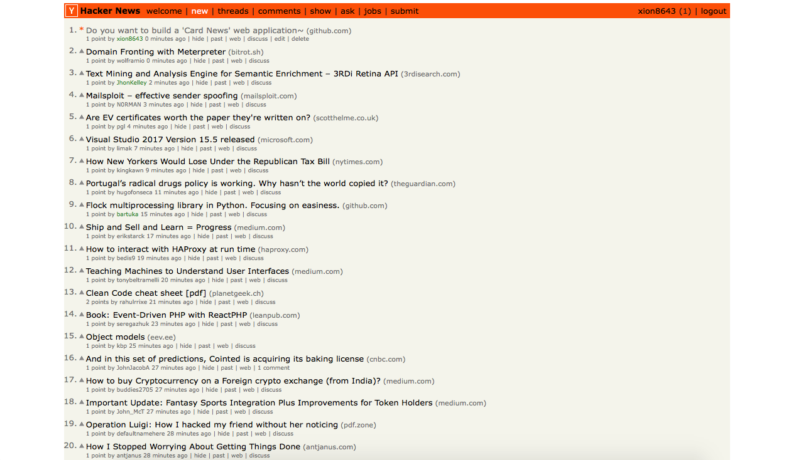
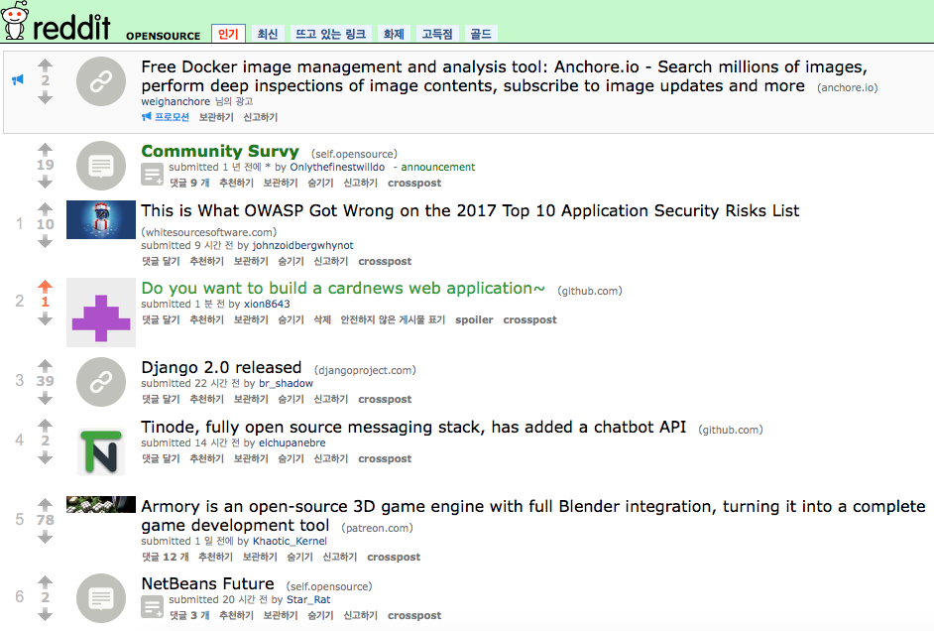
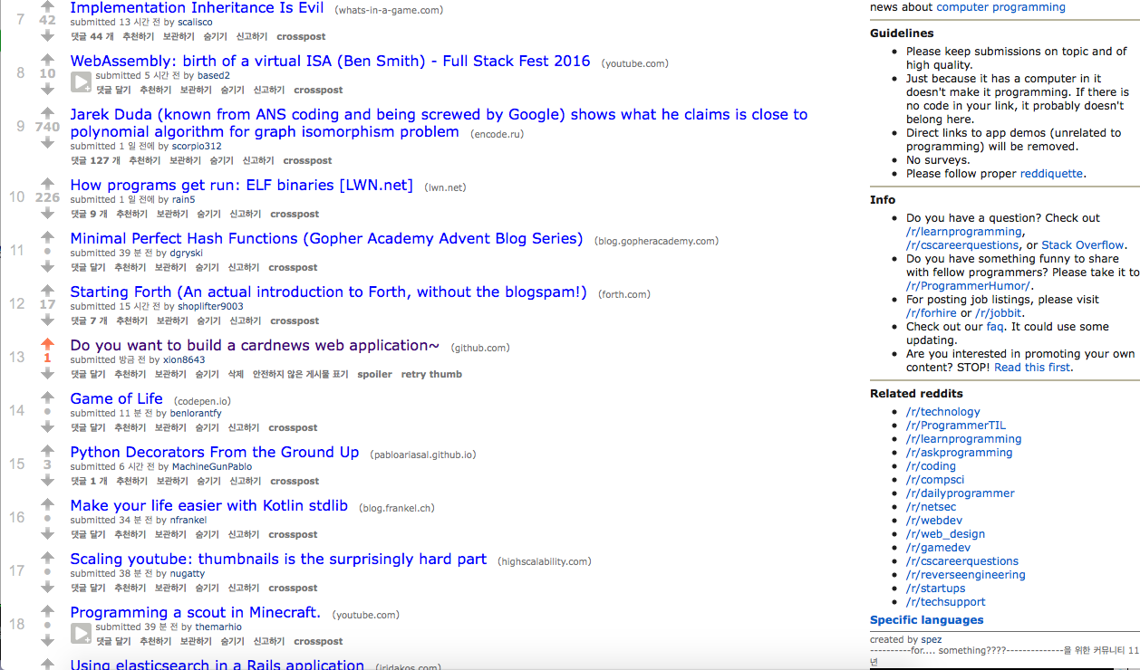
05
Promotion
Opensource 서브레딧
Promgramming 서브레딧
Hacker News

Slide 16
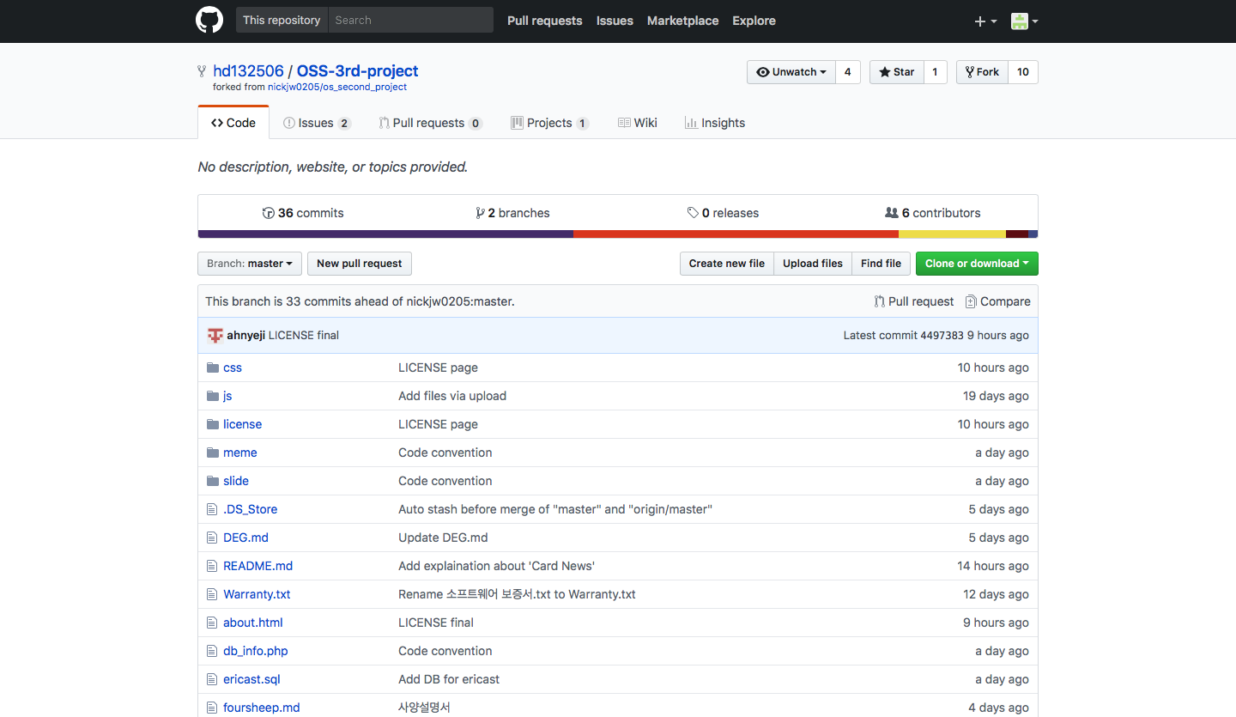
05
Promotion

Slide 17
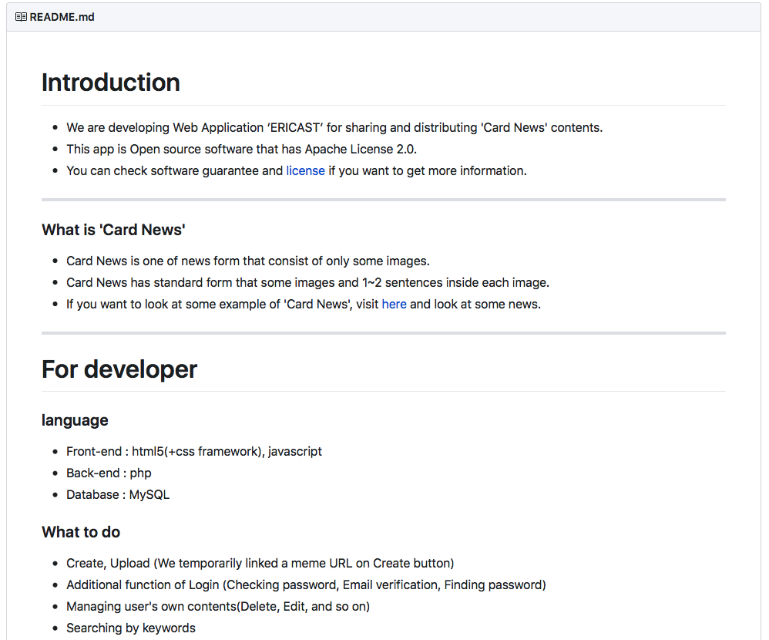
05
Promotion

Slide 18
THANK YOU

